Slide 1
Here’s the execution plan Now what?
Hugo Kornelis (he/him)
Database consultant

Slide 2

Hugo Kornelis
I make SQLServerFast.com
Execution Plan Reference: https://sqlserverfast.com/epr
Detailed description of all operators, and other relevant information
I make SQL Server Fast

Slide 3
Hugo Kornelis
I make SQLServerFast.com
Execution Plan Reference: https://sqlserverfast.com/epr
Execution Plan Video training: https://sqlserverfast.com/video
In-depth training courses on execution plans
Limited time offer: 10% off with code “given in delivery” (expires dd-mm-yyyy)

Slide 4
Hugo Kornelis
I make SQLServerFast.com
Execution Plan Reference: https://sqlserverfast.com/epr
Execution Plan Video training: https://sqlserverfast.com/video
Other content
Blog: https://sqlserverfast.com/blog
Articles: https://sqlserverfast.com/articles
Longer, even more detailed in-depth information
Resources
Deck and demo for this session (and others)
Go to sqlserverfast.com, then Other / Presentations / Presentation resources

Slide 5
Hugo Kornelis
I make SQLServerFast.com
I do other community things
I work (consulting, training)
Contact details
Email: hugo@perFact.info
Twitter: @Hugo_Kornelis

Slide 6

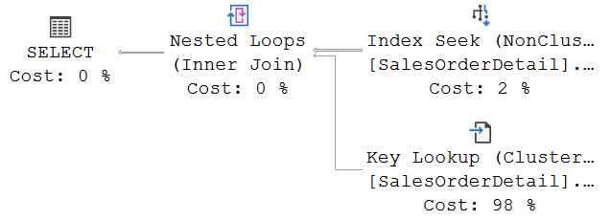

Learning execution plans
This long text in a tiny font represents a long explanation by the teacher of the sample execution plan shown, such that everyone in the audience understands how all the operators interact with each other. I made it deliberately extremely long and then the font extremely small because the actual text is not relevant; this is just an illustration of the process of learning to understand execution plans.

Slide 7
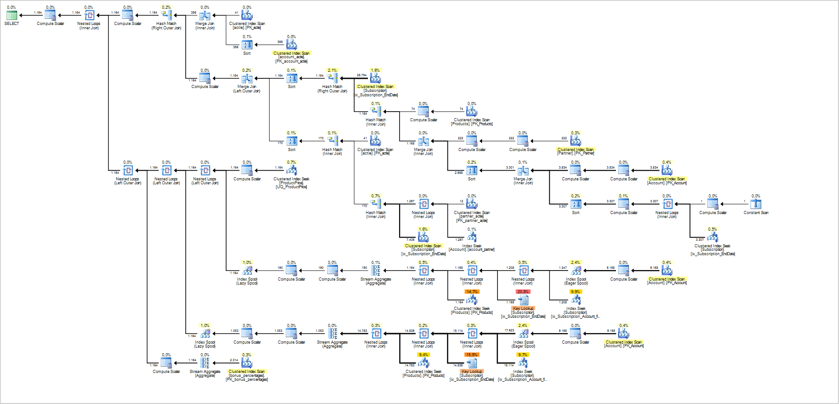

Working with execution plans
????

Slide 8
Bridging the gap
Sample execution plans
Realistic scenarios
Medium complexity
Cases
Excessive I/O
High resource semaphore waits
Erratic query performance
https://tinyurl.com/HugoConf

Slide 9
Excessive I/O
DEMO

Slide 10
High resource semaphore waits
DEMO

Slide 11
Erratic query performance
DEMO

Slide 12
T H E E N D
Questions?
Email: hugo@perFact.info
Twitter: @Hugo_Kornelis

Slide 13
T H E E N D
Questions?
Email: hugo@perFact.info
Twitter: @Hugo_Kornelis

